Slide 1
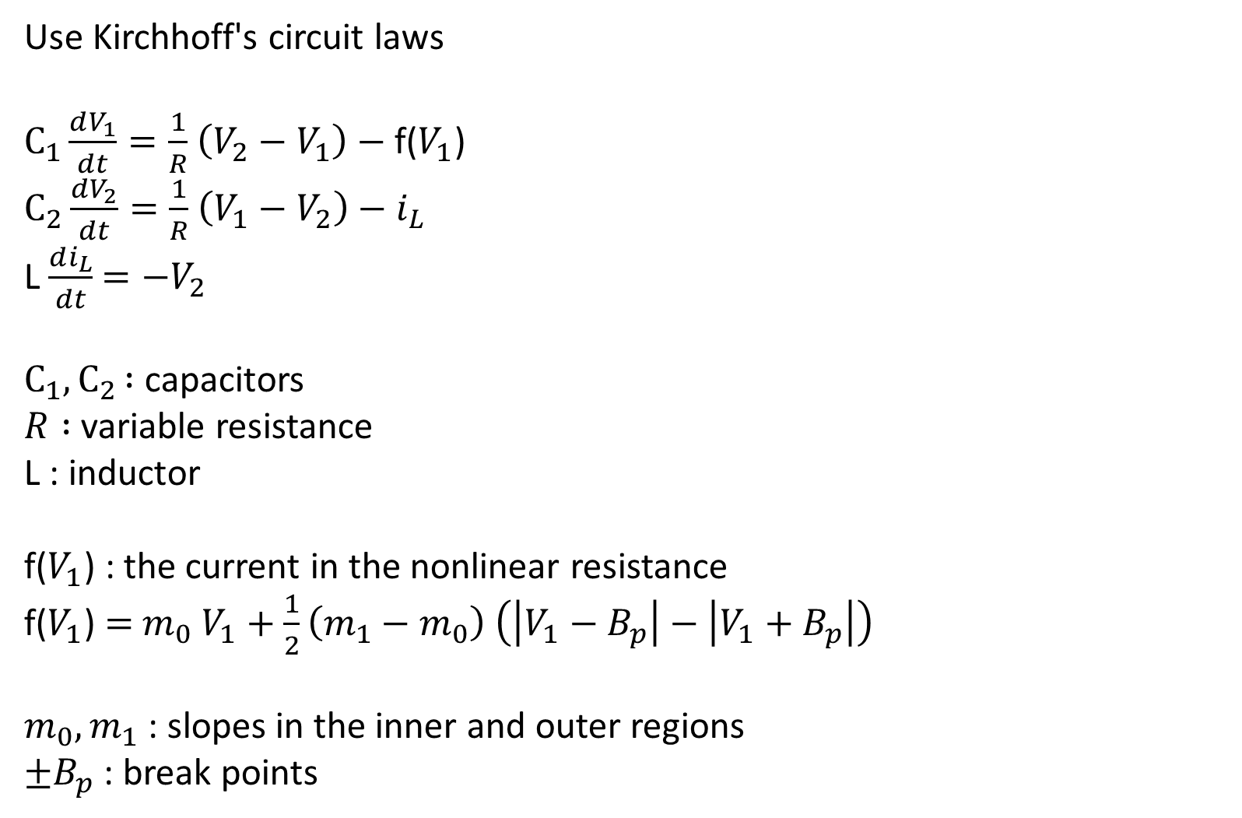
Use Kirchhoff's circuit laws
$C_{1}\frac{dV_{1}}{dt}=\frac{1}{R}$ $\left(V_{2}−V_{1}\right)$ $−$f($V_{1}$)
$C_{2}\frac{dV_{2}}{dt}=\frac{1}{R}$ $\left(V_{1}−V_{2}\right)$ $−$ $i_{L}$
L $\frac{di_{L}}{dt}$ $=−V_{2}$
$C_{1}{,C}_{2} :$capacitors
$R :$variable resistance
L : inductor
f($V_{1}$) : the current in the nonlinear resistance
f($V_{1}$) $=$ $m_{0}$ $V_{1}+\frac{1}{2}\left({m_{1}−m}_{0}\right)$ $\left(\left|V_{1}−B_{p}\right|−\left|V_{1}+B_{p}\right|\right)$
$m_{0},m_{1}$ : slopes in the inner and outer regions
${±B}_{p}$ : break points

